Slide 1

Analyzing Means of Commute to Work in the United States:
US Census Data Exploration
Sagar D. Goswami
AIT-580 | Data Analytics Research Project
Dr. Foxwell

Slide 2
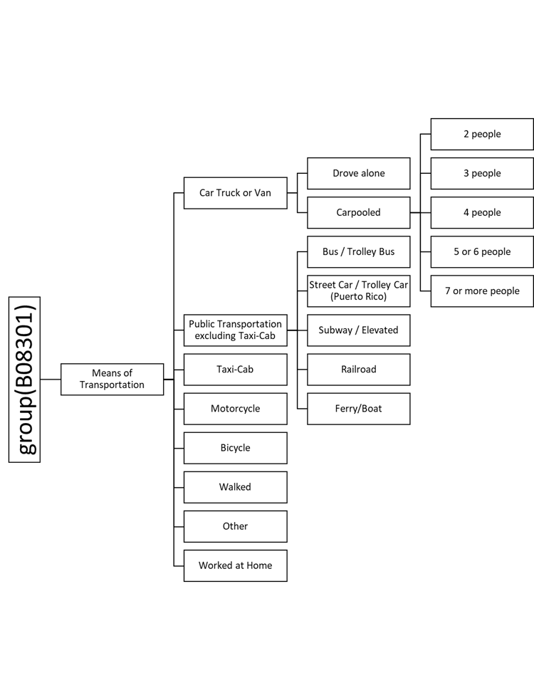
Annual 1-Year American Census Survey (ACS)
Accessed through the US Census Data API
Data for entire US, Regions, Divisions, States, and County formats
21 Key Metrics for “Means of Transportation to Work”

Slide 3
Research Questions
What is the trend for Public Transportation Usage in the United States?
Identify the regions, which have scope for improving the Public Transportation System
Is there any significant relationship between Public Transportation Usage and other socio-economic variables?

Slide 4
Research Methodology
Data Ingestion
Data Cleaning
Data Manipulation / Wrangling
SQL
R
Python
Data Exploration
Data Visualization
Calling API
Remove unnecessary columns
Re-order Dataset
Export
Make Schema
Importing Dataset
Linear Regression
Data Analysis
Spatial Map Plots
Scatter Plots
PTScore Calculation
General Statistics
Import JSON to a Pandas Dataframe
Remove empty rows
Rename Columns (Web Scraping)
Merge Datasets

Slide 5
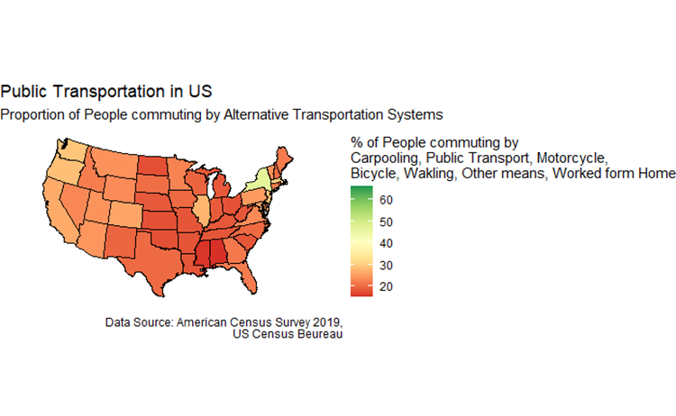
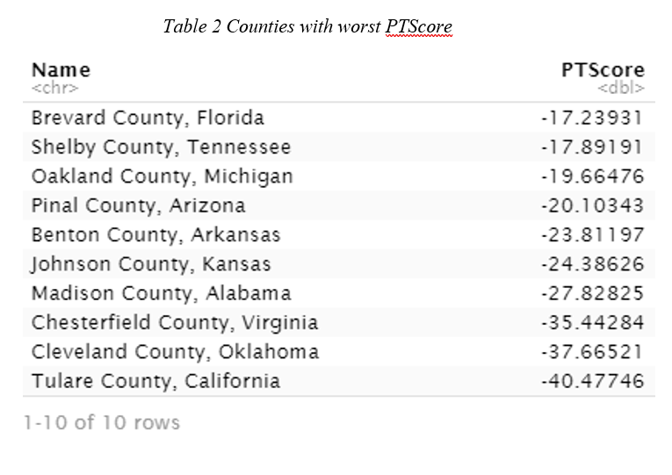
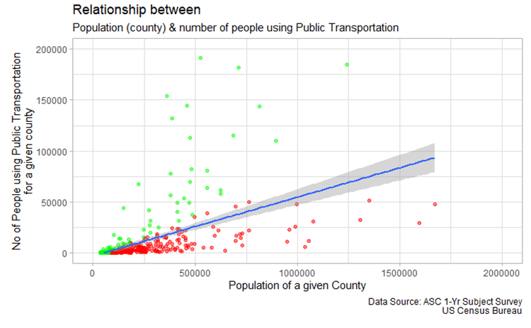
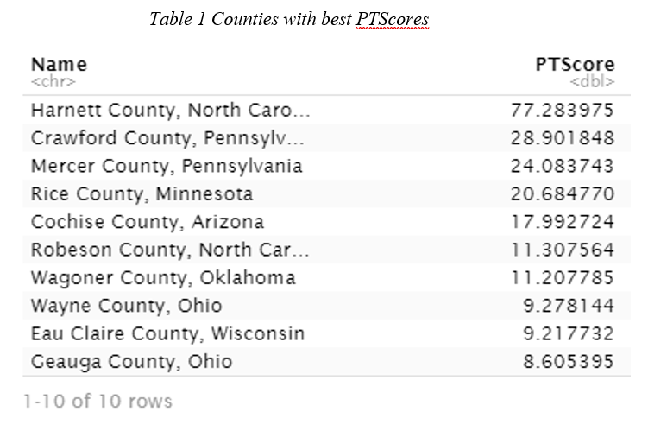
Research Findings

Slide 6
Lessons learned from the Project
Explore and understand the variety of Public-Access data, provided by the US Census Bureau
Calling and fetching data through APIs
Understand and explore use cases for different programming tools (Python, SQL, R)
Working with Spatial Map Data, and visualizing map data

Slide 7
Thank You!

